Slide 1
Olist Payments & Monetisation Analysis
Module 4. Sprint 3. Matas Mostauskis

Slide 2
Olist
Today, we will be analyzing payment data of Olist – a Brazilian ecommerce marketplace which allows different people to sell their different goods all across Brazil.

Slide 3
Questions
Before performing this payments & monetization analysis of Olist, I have asked myself several questions that would guide my analysis:
What data am I working with? (time span, record count)
What metrics should I prioritize?
How do different variables relate to each other?
What conclusions can I draw from the data?

Slide 4
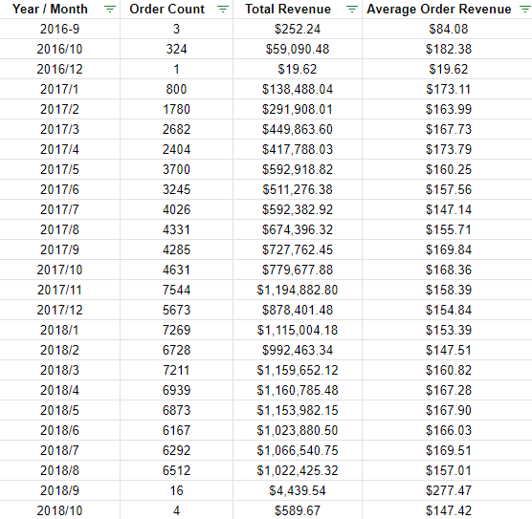
Data
We have data that spans from 2016/09 to 2018/10.
We are missing 2016/11 data and have seemingly very limited 2016/09 and 2016/12 data.
2018/9 and 2018/10 also seems to be either be missing some data, or/and has corrupted data.
I have, therefore, decided to cut out the 2016 and 2018 September and October data, identifying it as outlier data, which can distort my analysis.

Slide 5
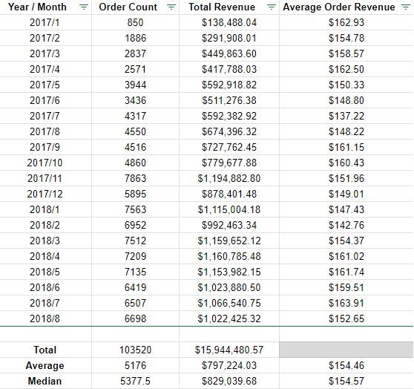
Averages
Over this time period, the average monthly order count was 5176.
Average monthly revenue was 797,224$.
Average Order Value – 154.46$
Differences between Average and Median values were relatively miniscule.

Slide 6
KPIs
Total Unique Users – 99440
Total Payments – 103886
Min Payment Value was 0$
Max Payment value was 13,664$
Average Transaction Value – 154.46$

Slide 7
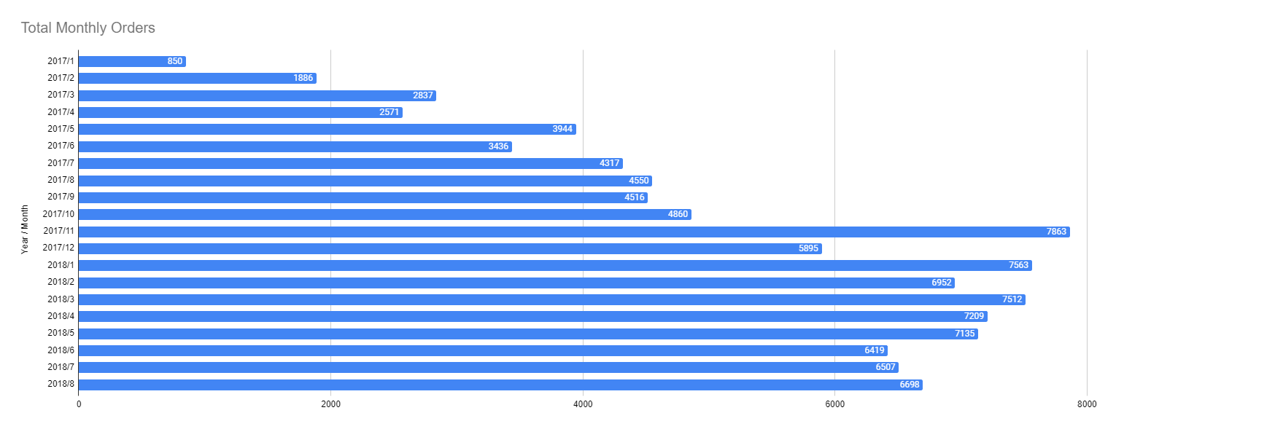
Monthly Orders
We can clearly see that starting with 2017, the monthly orders began to sharply rise.

Slide 8
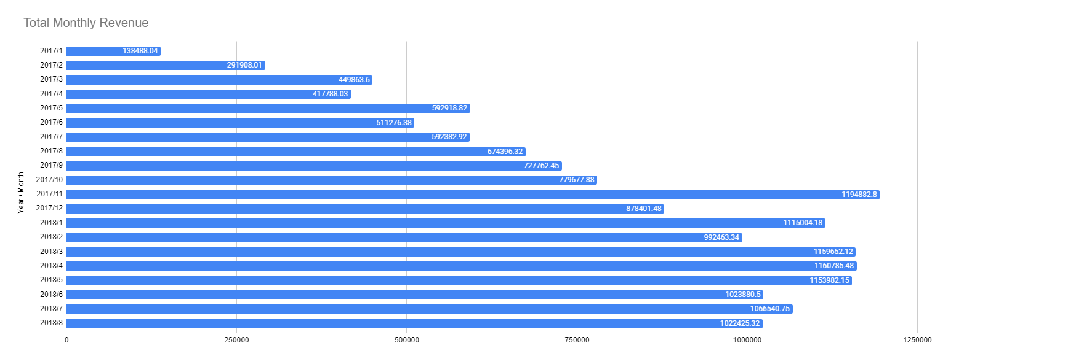
Monthly Revenue
The revenues also began to rise starting with 2017.
The order/revenue contrast is very proportional

Slide 9
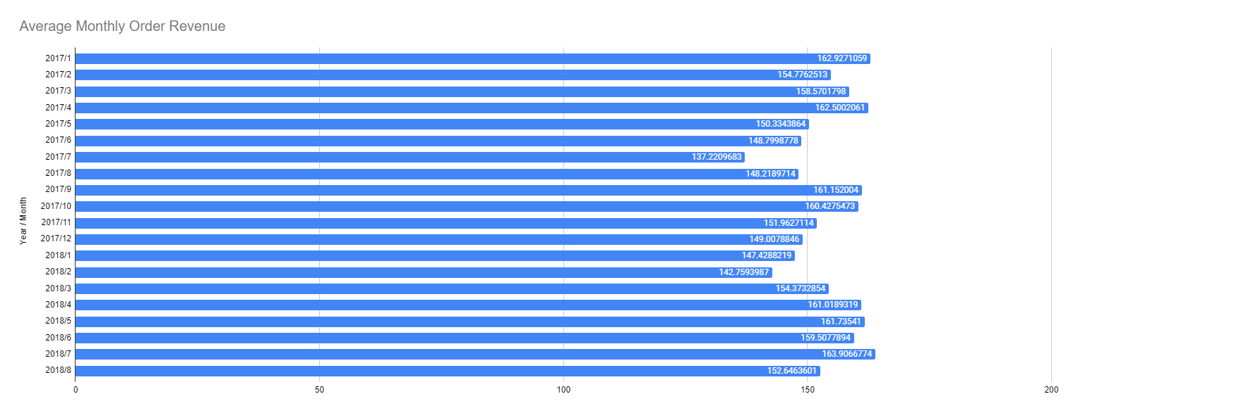
Average Monthly Order Revenue
The average order value for each month is very similar across the data, except for 2016-09, 2016-12 – they are significantly lower, but we are working with very limited data.
In 2018-9, the average order value was almost twice as valuable as it was in the most other months.

Slide 10
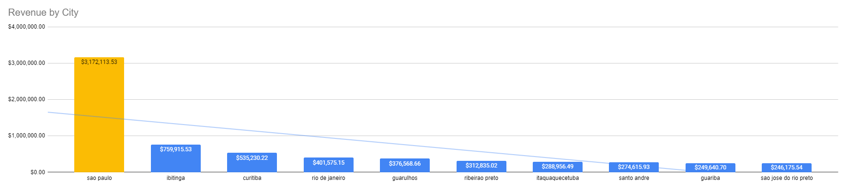
Top 10 Cities by Total Revenue
Looking at the top 10 cities, generating the most revenue, we can see a stark difference between Sao Paulo and others.

Slide 11
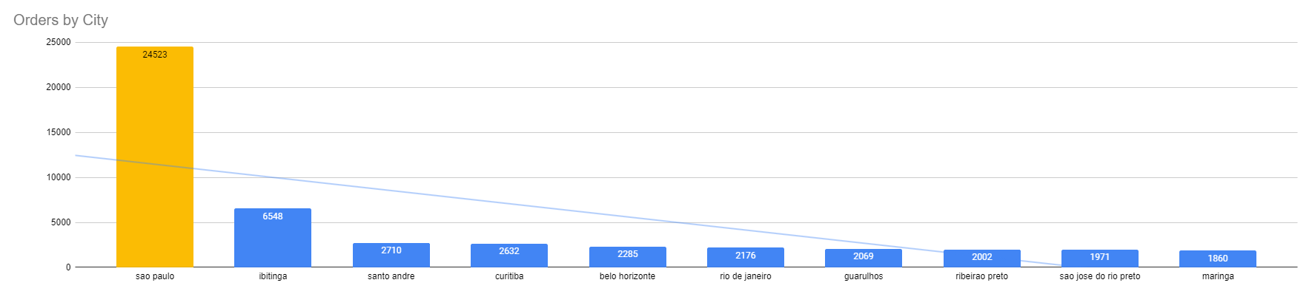
Top 10 Cities by Total Orders
We can also see, that orders data shows a similar image. Top 2 cities are Sao Paulo and Ibtinga. However, certain others, starting with Santo Andre change places, compared to top cities by revenue.

Slide 12
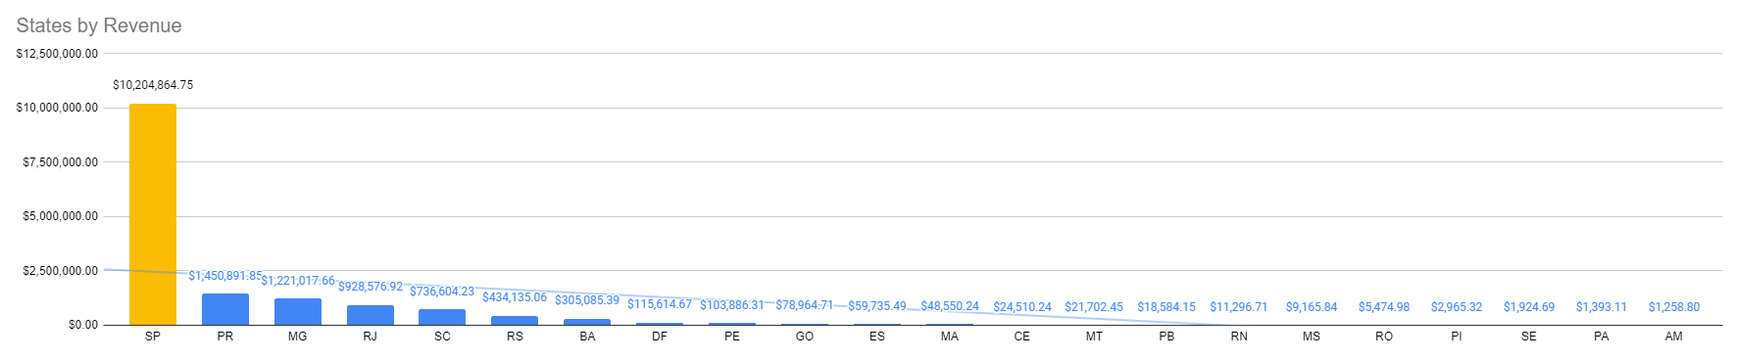
States by Total Revenue
In terms of states by revenue, we can see how differentiated Sao Paulo is, with a very sharp drop off following it. Sao Paulo takes up more than half of the total revenue.

Slide 13
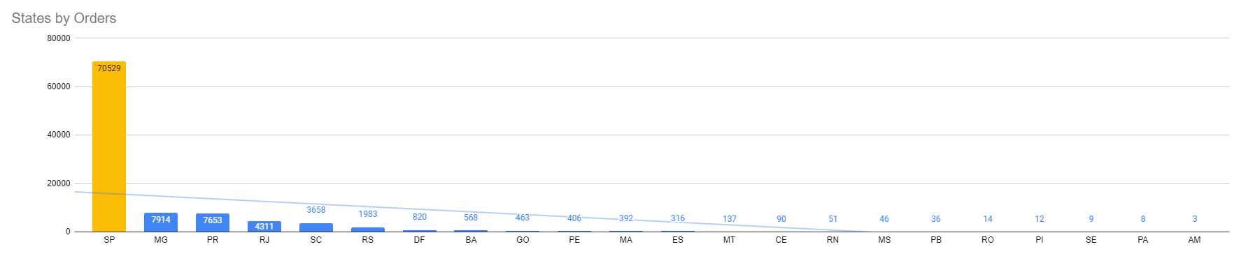
States by Total Orders
Similar tendencies are seen when looking at order data. Although, here, Minas Gerais takes over Paraná, slightly. And that is also the case for some other less important states. Which indicates that revenue and orders count is not perfectly proportional.

Slide 14
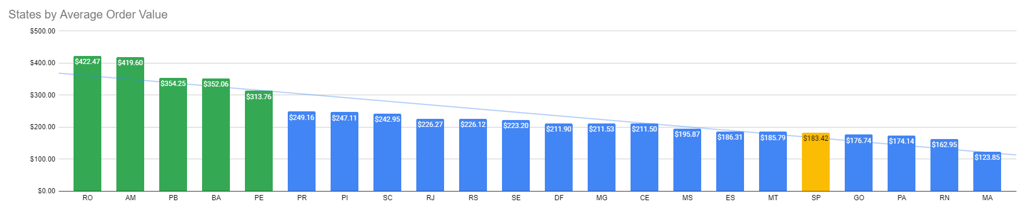
States by Average Order Value
Looking at the average revenue per order, we can see that states like Rondonia, Amazona, Paraíba, Bahia and Pernambuco suddenly become much more important because their average order values outperform the overall state average – 154.46$ by more than twice. This chart is radically different than the previous two.

Slide 15

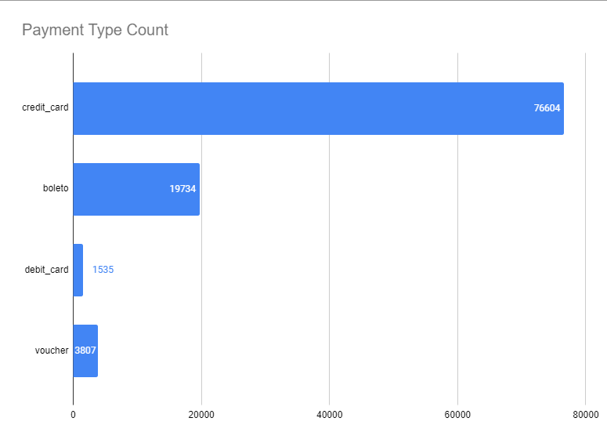
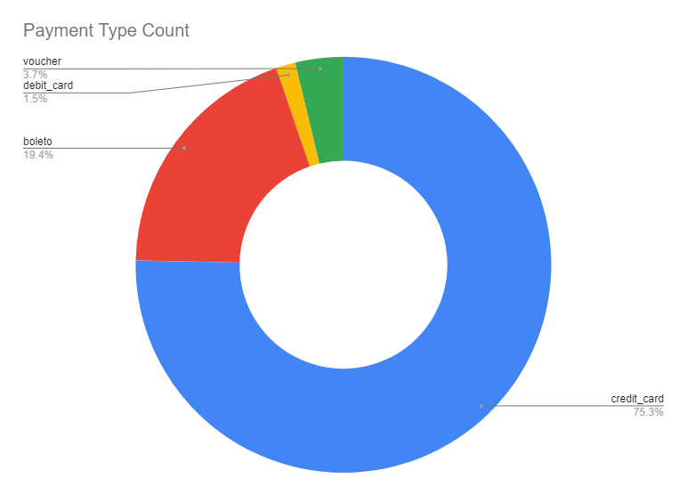
Total Payment Type Orders
We can see, that most of the orders came from credit cards, with boleto (ticket) taking far second place, vouchers third and debit cards the very last.

Slide 16
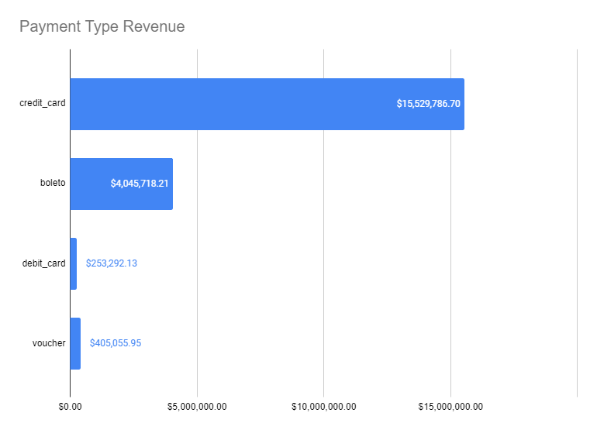
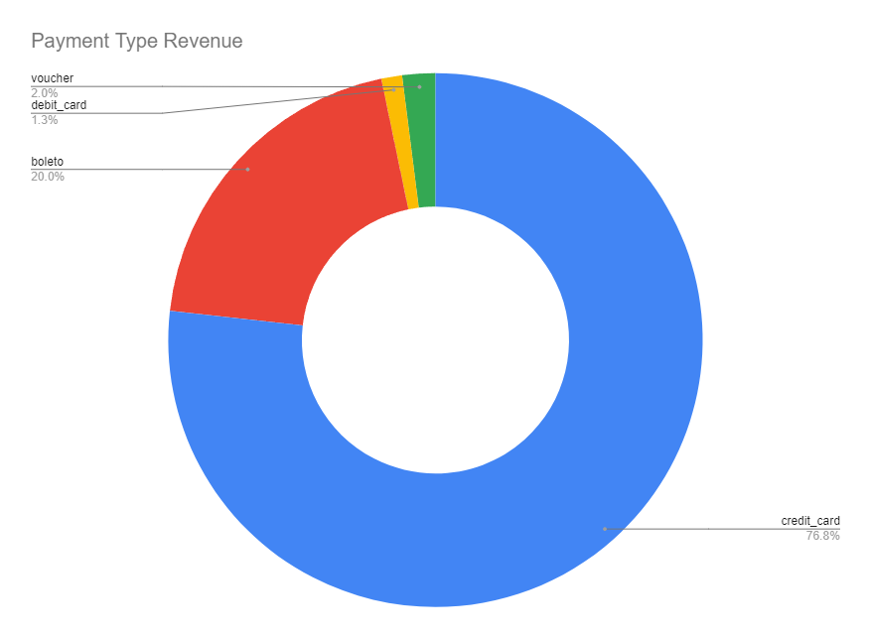
Total Payment Type Revenue
Revenue by payment type is also very proportional to the order count, the biggest difference is voucher transactions being a lot less valuable than debit card transactions.

Slide 17
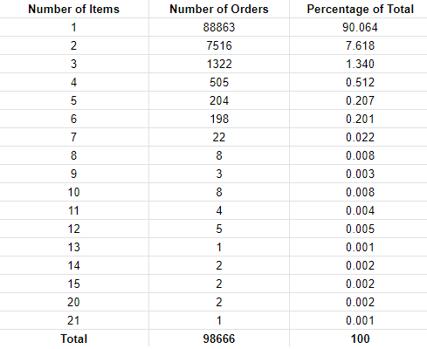
Orders by Number of Items Bought
We can see, that a little over 90 percent of all orders only ordered 1 item.
7.6 percent ordered 2.
1.34 percent ordered 3.
A very sharp drop off occurs from then on.

Slide 18
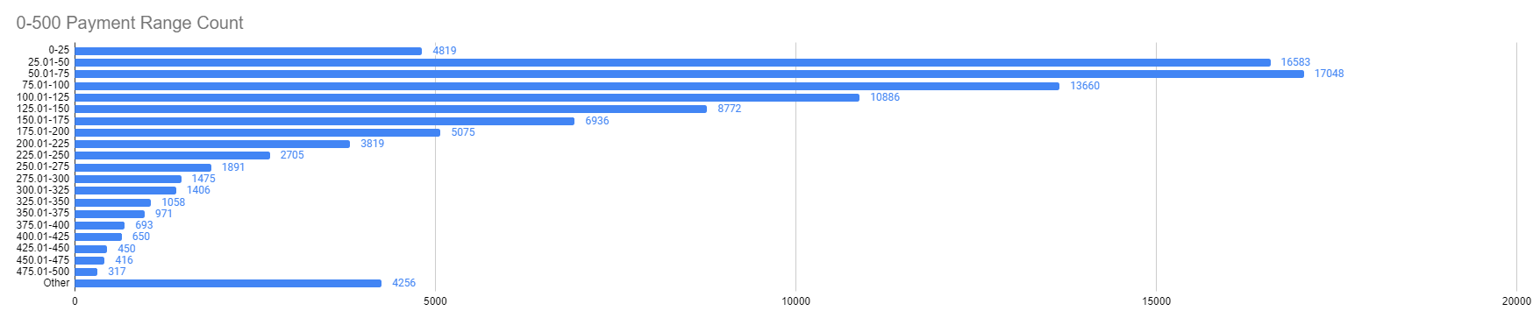
Payment Segments By Total Orders
Looking at payment segments, we can see that most of them tend to be around 25-50, 50-75, and then slowly drop off after the 100 dollar mark.
Payments above 500 dollars, take up significantly smaller proportions

Slide 19
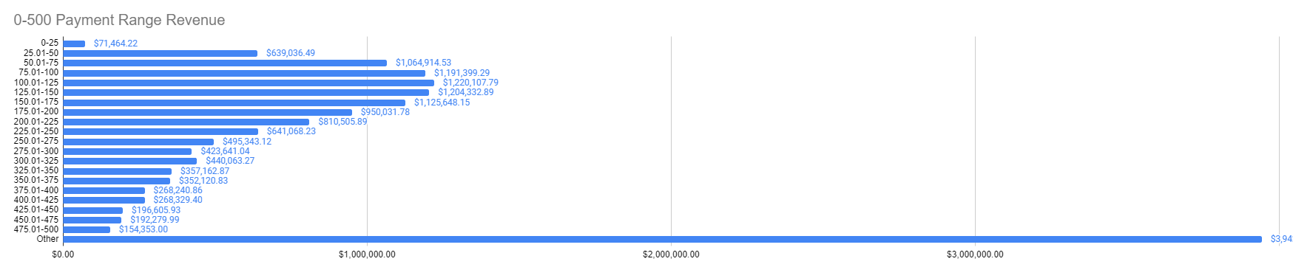
Payment Segments By Total Revenue
In terms of revenue generated, differences between 0-500 dollar segments are less pronounced than they are with the total orders. Higher revenues tend to make up the smaller order volumes.
Other – the segment of any payments above 500 dollars, suddenly takes up almost 4 million dollars in revenue. A stark contrast with the amount of orders generated by this segment.

Slide 20
Conclusion
We have a roughly 2 year data, with a missing November of 2016.
Both the orders and the revenues rose sharply in 2017 and 2018.
Most of the orders and revenue came from Sao Paolo city and its state.
Highest average order values came from Rondonia, Amazona, Paraíba, Bahia and Pernambuco states.
Four total payment methods were used. Credit cards took up 3 quarters of the orders and revenues.
90% of orders bought one item. 7% bought 2. Sharp drop off after that.
Most of the payments tend to be in the 25-200 dollar segments. Very sharp drop off after that.
The Pareto principle can be clearly seen in the data – majority of the sales and revenue come from a minority of cities and states (Primarily Sao Paulo), by minority of people and mostly using a single payment method.

Slide 21
Actionable Insights
I believe, that the company might want to focus it’s marketing in the Rondonia, Amazona, Paraíba, Bahia and Pernambuco states, considering their high value orders.
Make sure that credit card and then ticket purchases are very easy, fast and safe to do, considering how prevalent they are.
Focus on marketing 25 to 200 dollar items, because the revenues and volumes are the biggest in this segment.
Improve incentivization of multiple item orders might be preferred, Considering that 90% of all orders only bought one item.
And also, do more to attract returning customers, perhaps with email marketing, social media marketing, specialized deals and so on.
One more extra insight – the company should do a better job at keeping its database “clean”, as some of the names and general data seems to be either missing or corrupted.

Slide 22
Thank You for Your Attention

